Slide 1
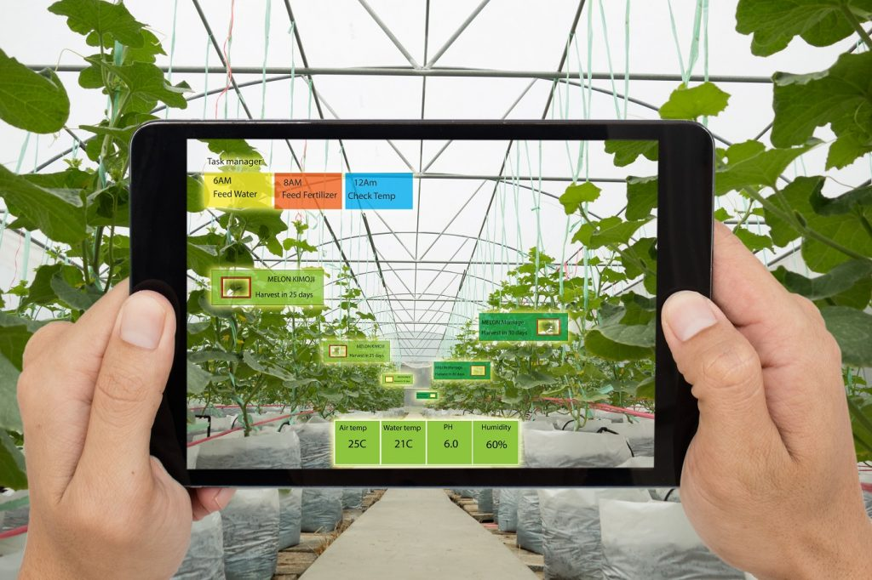

Artificial Intelligence
In
Agriculture
This Photo by Unknown Author is licensed under CC BY

Slide 2
How can we use Artificial Intelligence in Agriculture to boost, It’s Production, reduce cost and manpower?

Slide 3
Some Regular terms:
* Detection- the action or process of identifying the presence of something concealed.
* Diagnosis - the identification of the nature of an illness or other problem by examination of the symptoms

Slide 4
WHAT IS THE NEED FOR PLANT DISEASE DETECTION ?
Early and accurate detection and diagnosis of plant diseases are key factors for reduction of loses and spreading of diseases.
To assess the effectiveness of application of cultural, physical, chemical, or biological methods of containing the pathogens
To assess pathogen infection in plant materials in breeding programs.
To detect and identify new pathogens rapidly to prevent further spread.
To Study pathogenesis and gene functions.

Slide 5
To resolve the components of complex diseases incited by two or more pathogens. Common methods for the diagnosis and detection of plant diseases include
1. Visual plant disease estimation by human raters,
2. Microscopic evaluation of morphology features to identify pathogens
3. Molecular diagnostic techniques
4. Serological assays
5. Microbiological diagnostic techniques

Slide 6
Traditional, visual estimates identify a disease based on characteristic plant disease symptoms (e.g., lesions, blight, galls, tumors, cankers, wilts, rots, or damping-off) or visible signs of a pathogen (e.g., uredinospores of Pucciniales, mycelium or conidia of Erysiphales).
Visual estimation is performed by trained experts and has been the subject of intensive research and investigation.
Visual estimation has become more accurate and reliable due to the availability of detailed guidelines and standards used for assessment training

Slide 7
Conventional methods of plant disease detection
Conventional methods of plant disease detection include molecular and serological methods that could be used for highthroughput analysis when large numbers of samples need to be analysed.
In these methods, the disease causing pathogens such as bacteria, fungi and viruses are directly detected to provide accurate identification of the disease/pathogen.
All of these methods are time consuming and also require highly sophisticated laboratories and highly skilled people.
These methods cannot be applied on a large scale and also they are not cost effective

Slide 8
Scope of Al in agriculture
Agriculture is seeing rapid adoption of Artificial Intelligence (Al) in terms of agricultural products and in-field farming techniques.
Cognitive computing in particular is all set to become the most disruptive technology in agriculture services as it can understand, learn, and respond to different situations (based on learning) to increase efficiency

Slide 9
Image based insight generation
Images can help in in-depth field analysis, crop monitoring, scanning of fields and so on. Computer vision technology
Feeds from image data can generate alerts in real time to accelerate precision farming which aids in the following
a. Disease detection
b. Crop readiness identification and
c. Field management

Slide 10
Image Processing based detection of Plant Diseases
Digital photographic images are important tools in plant pathology for assessing plant health. Digital cameras are easy to handle and are a simple source of RGB (red, green, and blue) digital images for disease detection, identification, and quantification.
In recent times, server based and mobile based approach for disease identification has been employed for disease identification.

Slide 11

About Model:
Language Used: PYTHON
Python Library Used:-
Tensorflow- TensorFlow is a Python-friendly open-source library for numerical computation that makes machine learning and developing neural networks faster and easier.
Matplotlib- A python library primarily used as a utility library for its submodules used in ploting scientific graphs and analyzing the performance of the model.
Numpy- A python library primary used for matrix computations.
Keras-Keras is an open-source software library that provides a Python interface for artificial neural networks. Keras acts as an interface for theTensorflow library.
Sklearn- A python utility library primarily used for preprocessing the data for further processing.
This Photo by Unknown Author is licensed under CC BY-NC-ND

Slide 12
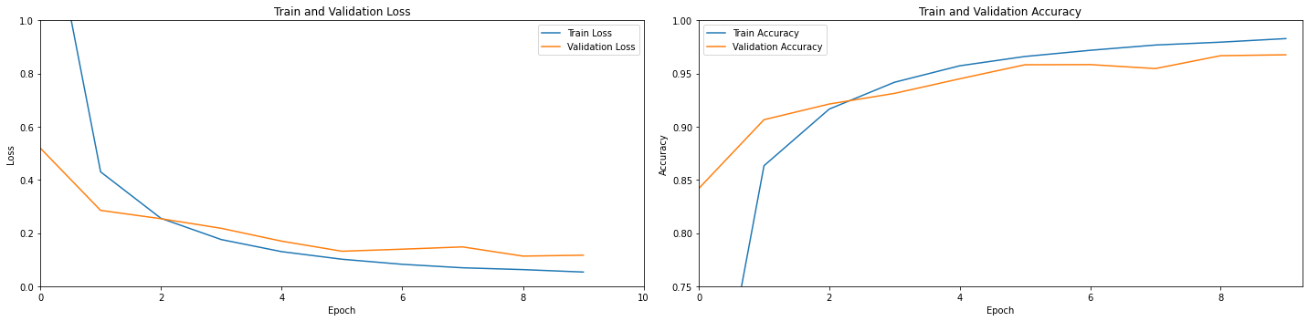
CONTd.
Train Accuracy : 98.29 %
Test Accuracy : 96.77 %
Precision Score : 96.77 %
Recall Score : 96.77 %
Dataset Image count : 87K or 87000
Number of epoch(Iterations) : 15 on dataset

Slide 13
What is CNN (Convolutional Neural Networks):
It is a class of artificial neural network most commonly applied to analyze visual imagery. CNNs use a mathematical operation called convolution in place of general matrix multiplication in at least one of their layers.
They are specifically designed to process pixel data and are used in image recognition and processing.
CNNs are also known as Shift Invariant or Space Invariant Artificial Neural Networks (SIANN), based on the shared-weight architecture of the convolutional kernels or filters that slide along input features and provide translation-equivalent responses known as feature maps.
Counter-intuitively, most convolutional neural networks are not invariant to translation, due to the down sampling operation they apply to the input.

Slide 14
What is Convolution?
It is a mathematical expression of two function (f and g) that produces third function ( f * g ) which expresses how the shape of one is modified by other. The word convolution refers to the both the result function and the process of computing it. It is defined as the integral of the product of two functions and after one is reflected about the y-axis and shifted. The choice of which function is reflected and shifted before the integral, does not change the Integral.

Slide 15
Future Prospects
Apart from detecting the plant diseases, Al has a wide range of application in agriculture.
Al is useful for the detection of pest damages, weeds, nutrient deficiencies.
Al powered robots are being developed for performing farm operations and also Al is being Introduced to farm vehicles.
Al powered sprayers with Al vision are being developed so that the spraying becomes more uniform and aids in targeted application of farm chemicals.
Al is being used for the prediction of weather parameters to suggest farmers the appropriate measures with respect to crop satety.
There is no wonder to say that in the near future, every aspect of the farming will be done by the machines powered by Al from sowing to harvesting.

Slide 16
Conclusion
When compared to the conventional methods of plant disease detection, Al based detection systems are highly efficient, requires less time, involves less cost and also don't require trained professionals.
The major advantage with Al is that it keeps on learning over the time. The best example is differentiating between the plant diseases and nutrient deficiencies, Al can be programmed accordingly so that it learns the changing pattern over time

Slide 17
Thank YOU

